Slide 1
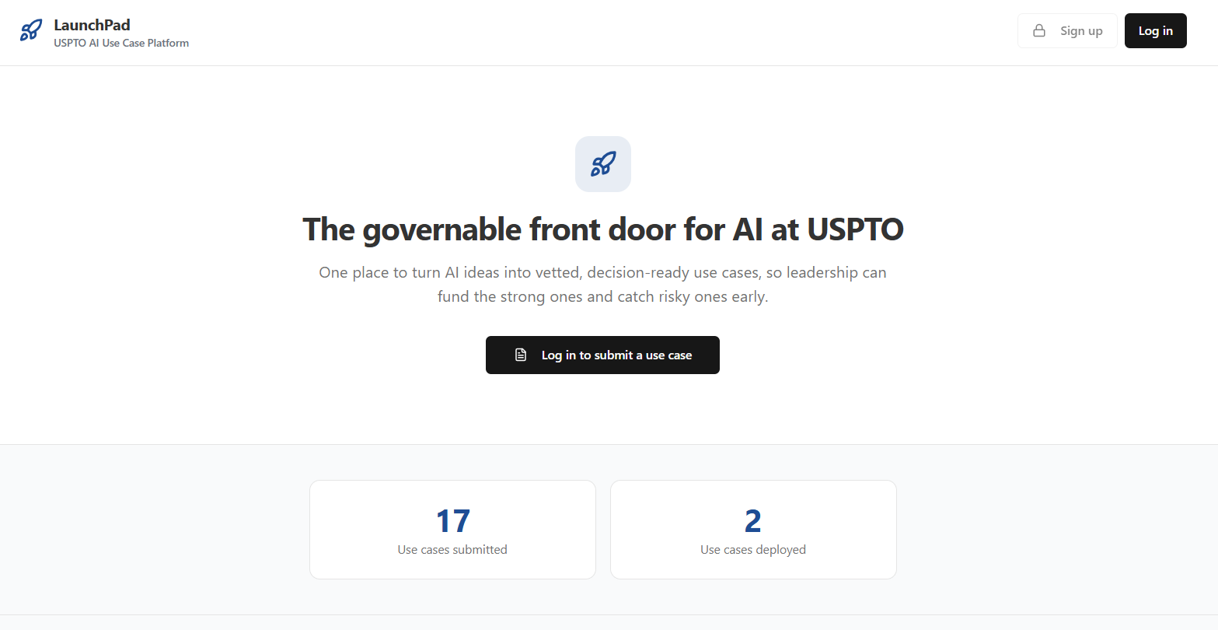
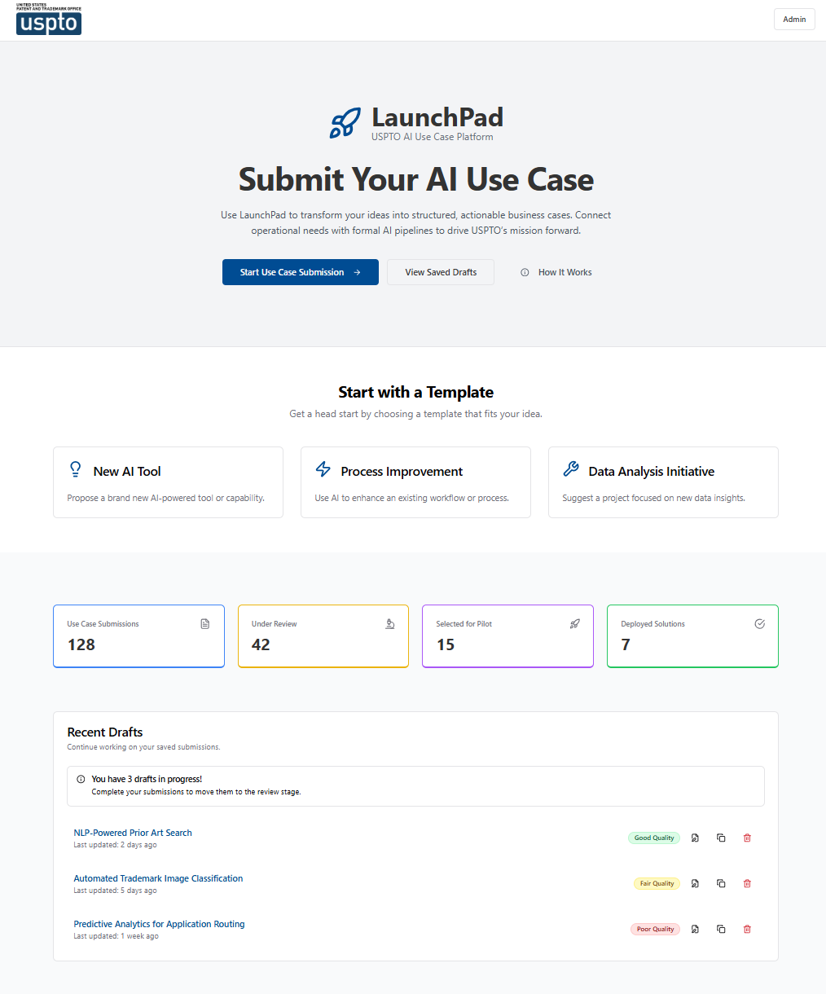
LaunchPad
The single-source for AI ideation and use-case management across your agency.
LaunchPad provides Agency leadership with a single, flexible platform to capture raw AI ideas from across the agency and refine them into decision-ready use cases. Users are guided through an AI-assisted workflow: they first identify business problems and then refine their ideas with an AI Copilot before submission. Once submitted, Launchpad provides Agency leadership with AI use cases that are ready for executive review.
Key Capabilities:
Guided AI-assisted workflow that transforms rough AI ideas into refined use cases that capture audience, business problem, value, and alignment to strategic objectives
AI Copilot challenges and refines each idea in real-time, identifying gaps before leadership ever sees it.
Configurable templates and smart fields (dropdowns, multi‑select chips, model card inputs) to meet DoC/OMB and governance requirements.
Routing capabilities to support review by E&I, CAIO, and OGL as needed.
Draft‑save and revision workflows for collaboration and iterative improvement before final submission.
Dashboard with live tracking: submitted, under review, approved, or deployed.
Exports to Rally (GovCloud) as Epics/Features and branded PDF business cases for executive review.
© 2026 Packaged Agile, LLC. Proprietary and Confidential.

Slide 2
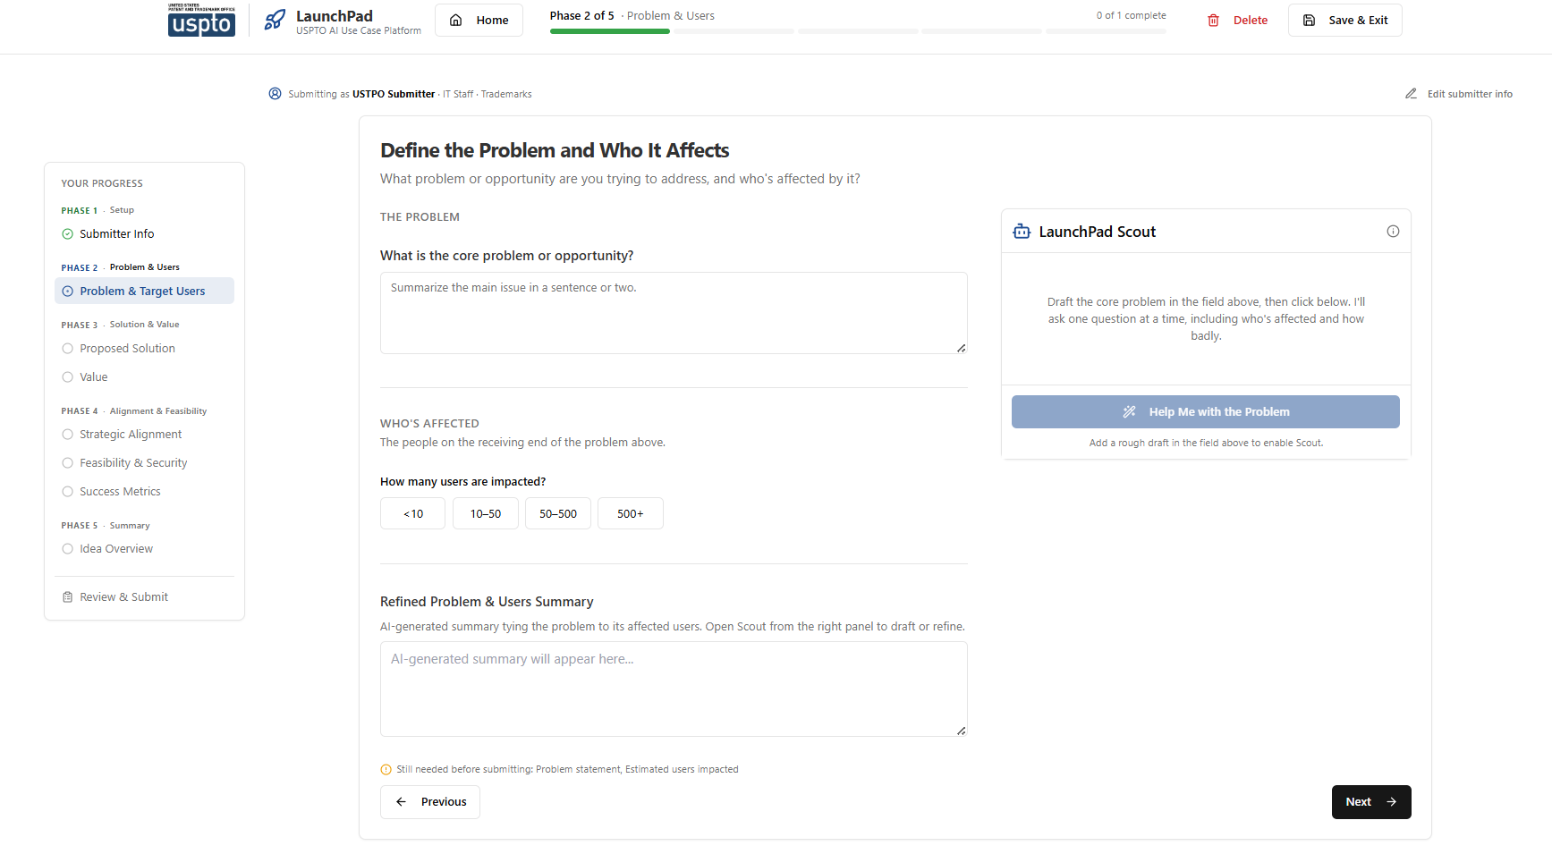
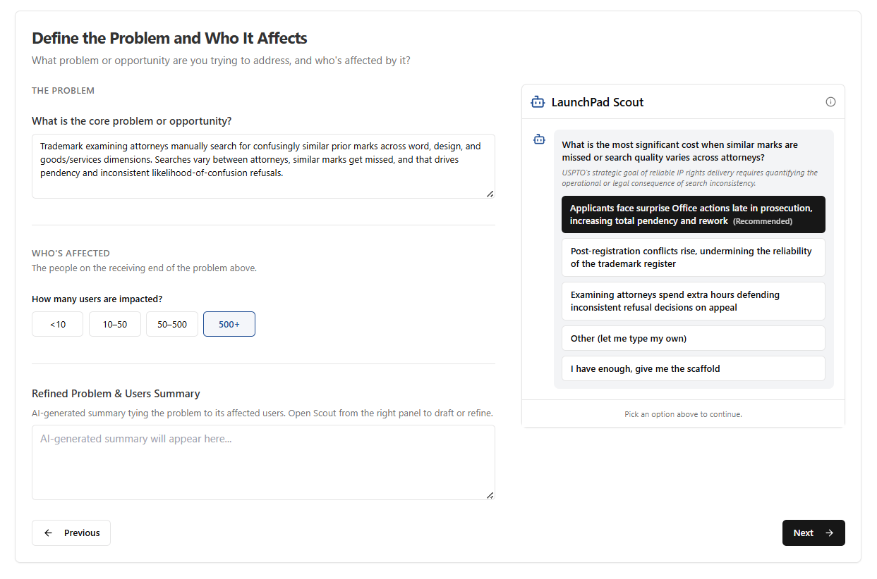
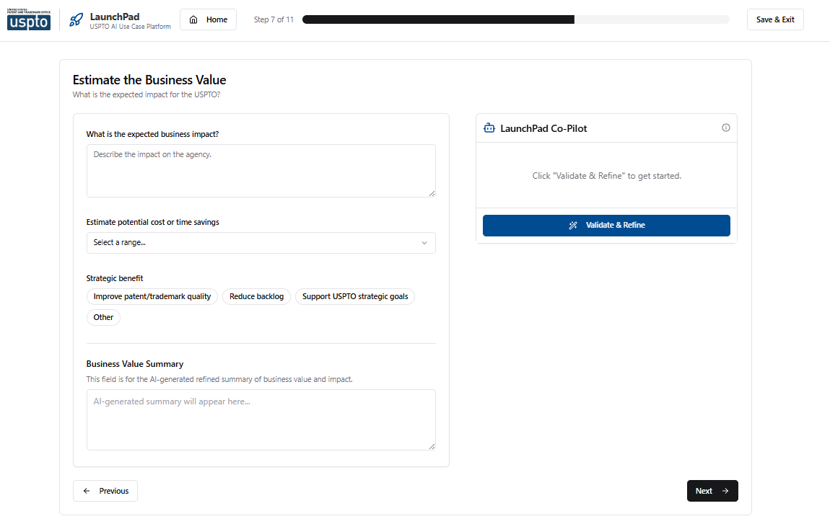
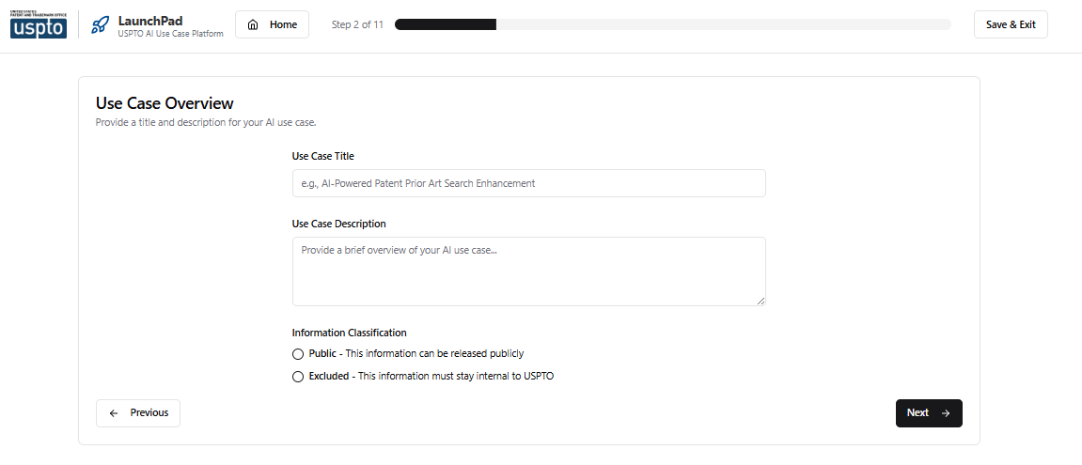
Guided Submission Workflow
Guided multi-step workflow vets raw ideas into decision-ready use cases with no training required
From Rough Idea to Business Case
LaunchPad walks every submitter through a structured, plain-language workflow that pressure tests their AI idea. Each step forces clarity on a specific dimension: audience, problem, solution, value, alignment, feasibility, and success metrics.
1–2
Submitter Info & Overview
Step 2: Use Case Overview
3–4
Target Users & Problem
5–7
Solution, User & Business Value
8
Strategic Alignment to OKRs
9–10
Feasibility & Success Metrics
11–12
Review, Submit & Confirm
© 2026 Packaged Agile, LLC. Proprietary and Confidential.
Step 7: Estimate Business Value with AI Co-Pilot

Slide 3



AI Co-Pilot: Validate & Refine
AI-powered vetting turns rough ideas into qualified, decision-ready use cases
How It Works
Architecture
At each step, the Co-Pilot challenges the submitter’s thinking, flagging gaps, questioning assumptions, and strengthening weak areas. One click generates a refined, submission-ready summary that’s already been pressure tested.
Next.js 14 + TypeScript
App Router, React Context
Tailwind CSS + shadcn/ui
Mission & Compliance Awareness
-branded components
Vets ideas against federal constraints, FedRAMP, 508, and your agency's realities
AI Integration Layer
Structured Output
Structured, validated responses from approved LLM
Schema-validated responses ensure consistent, well-formatted summaries every time
LLM Engine
Model agnostic. Adaptable to an approved endpoint
Dual-Field Architecture
Raw inputs preserved alongside AI-polished summaries
Flexible Deployment
Containerized for on-prem, Cloud.gov, or GovCloud
© 2026 Packaged Agile, LLC. Proprietary and Confidential.

Slide 4
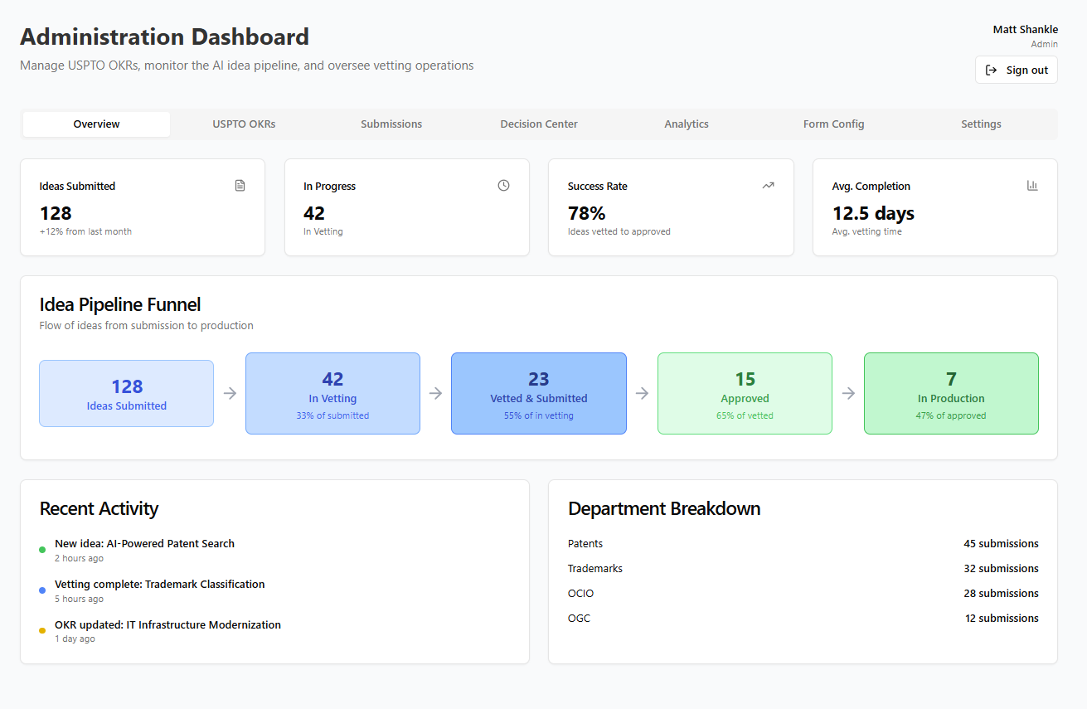
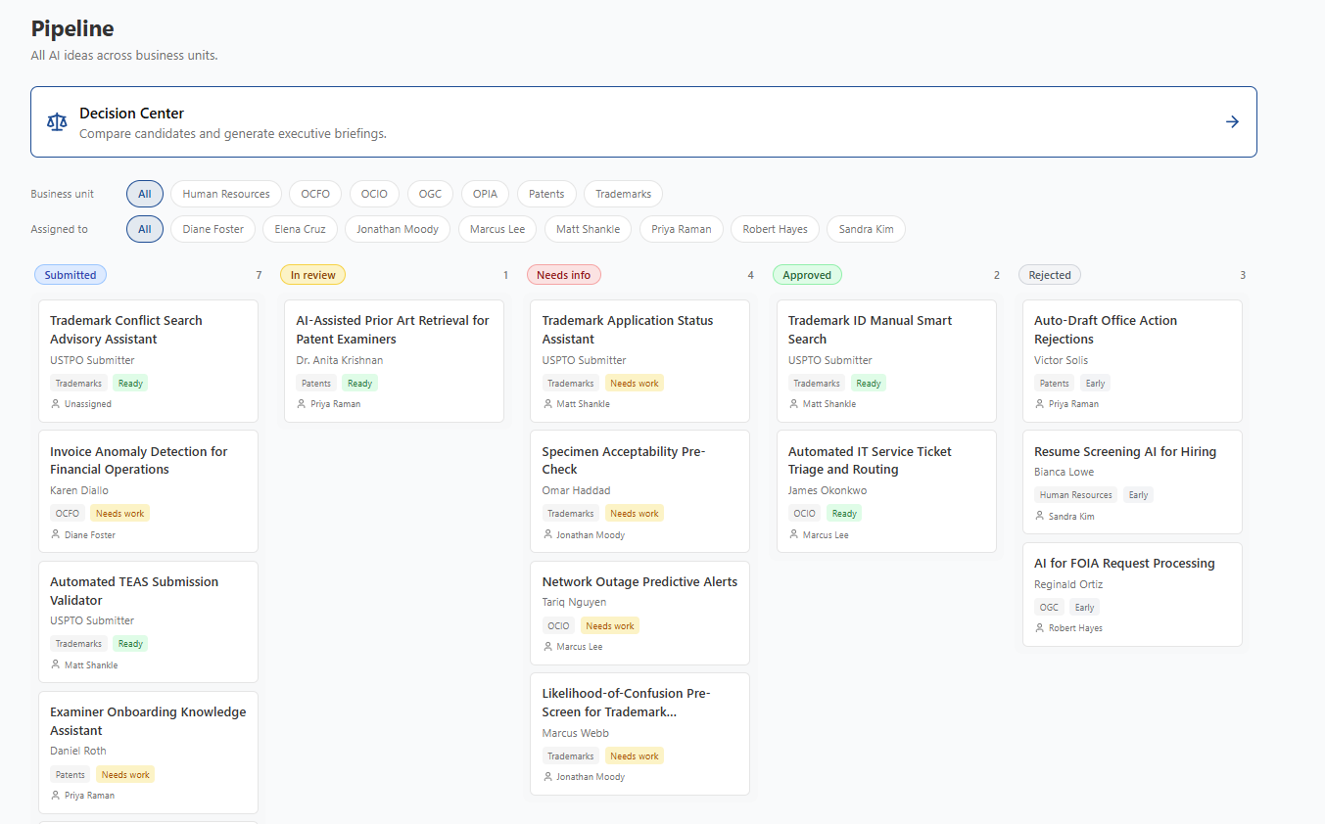
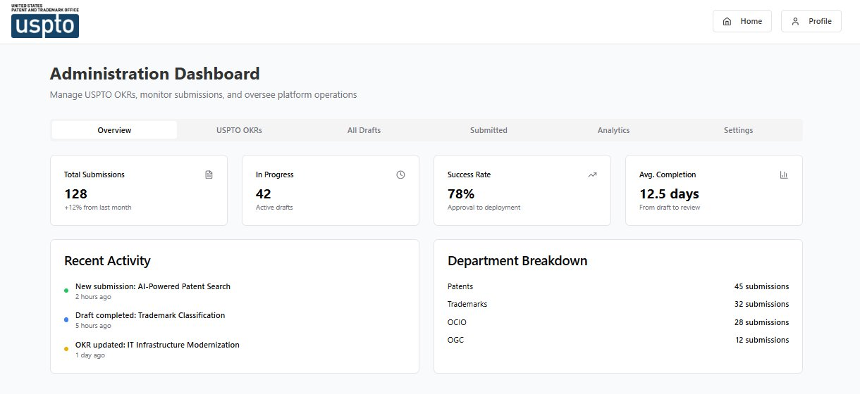
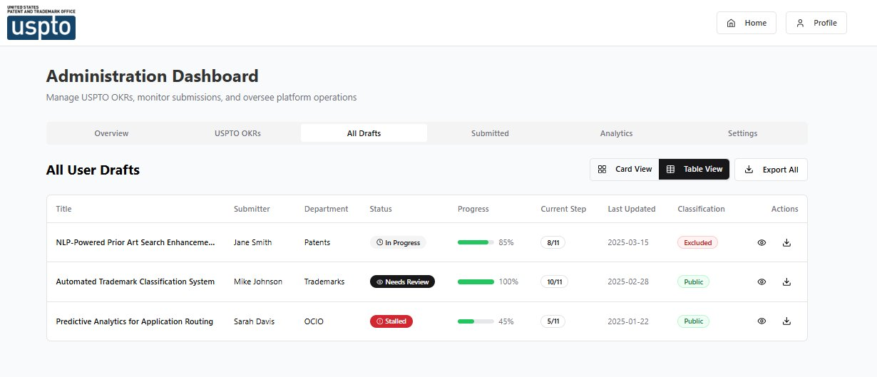
Administration Dashboard
Real-time visibility into the idea pipeline, from draft through approval
128
78%
12.5d
4
Total Submissions
Success Rate
Avg. Completion
Departments
+12% from last month
Approval to deployment
Draft to review
Patents, TM, OCIO, OGC
Overview: KPIs, Activity & Department Breakdown
All Drafts: Progress Tracking & Status Management
© 2026 Packaged Agile, LLC. Proprietary and Confidential.

Slide 5
Delivery & IP Model
A supported commercial capability — without the open-source burden on your team
Delivered and operated as commercial software by Packaged Agile — your team brings requirements and access, not hands on the source. Because government staff never author or modify the code, it stays a commercial product, not CC0 public domain.
Delivery
Intellectual property
Your team
We build and run it
Stays commercial
Requirements, not engineering
Vendor-operated
No CC0 exposure
Nothing to inherit
Delivered as a commercial item (GSA MAS schedule)
Packaged Agile owns the engineering and sustainment
Runs inside your accredited boundary (GovCloud)
Wired to your SSO and your approved model (Bedrock IL4/5)
▸
Your staff don't write or modify the source
So the code isn't government-authored — no automatic CC0
You receive a license to use and operate it
We retain and continuously improve the codebase
▸
No codebase to staff, secure, or sustain
Provide data owners and environment access
Shape the wizard, prompts, and governance with us
A supported, evolving capability — not a one-time handoff
Why it matters
Bottom line
The #1 federal-software trap: once a government employee writes or modifies code, it becomes CC0 public domain.
Keeping engineering on our side keeps your investment a supported product, not an open-source liability.
You still get full transparency, control, and an exit path — without inheriting the build.
You operate it. We build it.
The IP stays commercial — no open-source burden.
You get the capability without inheriting the codebase.
© 2026 Packaged Agile, LLC. Proprietary and Confidential.

Slide 6
Implementation Roadmap
Code-complete today: 8–12 weeks from kickoff to production
LaunchPad's codebase is built and functional. The path to production is adapting it to your agency's on-prem infrastructure, identity systems, and AI access requirements.
Phase 1
Phase 2
Phase 3
Foundation
AI & Integration
Harden
Weeks 1–4
Weeks 5–8
Weeks 9–12
Containerize application (Docker)
Deploy to hosting environment
Integrate SSO / identity provider
Stand up database & migrate persistence
▸
Configure approved AI gateway endpoint
Adapt prompts for production LLM
Build Rally (GovCloud) export
Review routing, notifications, & 508
▸
Security scanning & pen testing
UAT with pilot group
ATO documentation support
Production cutover & admin training
Decision Points
Key Assumptions
Hosting: On-prem, Cloud.gov, or GovCloud?
AI access: FedRAMP'd Anthropic, Azure OpenAI, or internal gateway?
ATO: Standalone, or inherit existing boundary?
Dedicated 2–3-person team with environment access from day one
technical POC empowered to unblock decisions
Hosting & AI endpoint available or provisionable within Phase 1
Lightweight ATO path (pilot authority or inherited boundary)
© 2026 Packaged Agile, LLC. Proprietary and Confidential.

